Slide 1
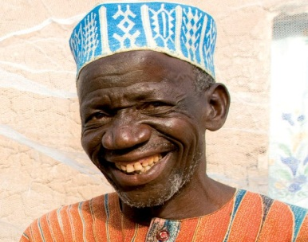





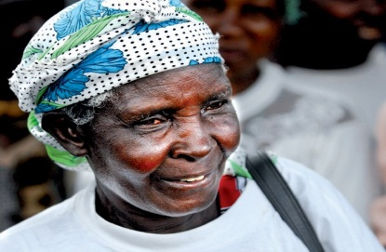

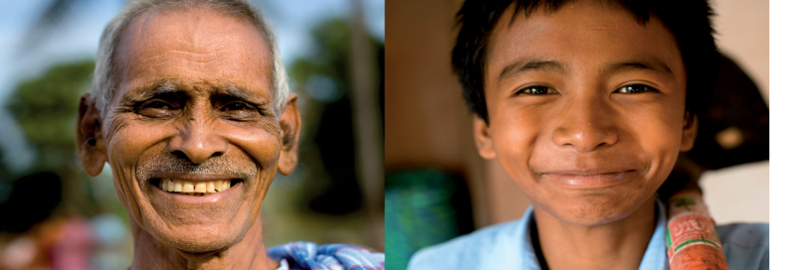
IFRC Y.E.S.
IFRC Youth Engagement Strategy
Notes:
This presentation aims to present the IFRC Y.E.S. comprehensively.
Presenters are encouraged to amend the presentation reflecting their audience and purpose of the presentation. Also adjust the animations of the slides as per the target audience.
Start with the questions why there are pictures of adults in the picture.
The Y.E.S. is the Youth Engagement Strategy not a Youth Strategy.
It is a strategic document enabling NSs to position themselves in the POST 2015 processes, as youth will be the key enablers of achieiving the global development goals in local communities.

Slide 2
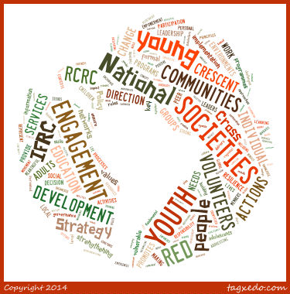
Notes:
Word bubble of the Y.E.S.: key words : Engagement, Communities, Development, Volunteers

Slide 3
Vision of youth engagement 2020
Young people will be living the RCRC Fundamental principles and Humanitarian values and they will excel as key RCRC actors in both alleviating human suffering and advocating for equality.
In the RCRC, young people will be treated with respect and as equal partners to adults. Intergenerational cooperation throughout the RCRC will result in humanitarian actions and extended partnerships that will increase the number of safe and resilient communities around the world.

Slide 4
Vision of youth engagement 2020 (cont.)
Young people, including those outside of the mainstream, will have opportunities responsive to their needs, potential, ambitions, and dreams and will be able to evolve personally, and secure livelihoods for themselves and their families.
Young people, knowledgeable and empowered to stay healthy, will assume roles as responsible members of their communities, will care for and engage with those in the shadows and those affected by the “Solferinos of the day”, being motivated by free will, as opposed to a desire for material or financial gain or by external social, economic, and political pressure.
Through, recognition ofyouth contributions and creation of space for youth by adults, young people will develop ownership for nurturing their communities and will favour ethical decisions that lead to collective community advancement over decisions of individual gain.

Slide 5
Principles of the Youth Engagement in RCRC
Youth engagement is intrinsic to building strong National Societies.
RC RC volunteerism is central to youth engagement and is an effective and meaningful way of youth civic engagement.
Education, Empowerment, and Enabling environments for young people are vital for youth engagement.
Youth are agents of change addressing global humanitarian challenges pertinent to local communities.
Youth in decision-making at all levels of management, governance, and service delivery are crucial for intergenerational transfer of experiences and continuity.
Notes:
First two slide of this presentation are to set the framework for the introduction of the IFRC Y.E.S.
This slide is about value and directions for youth engagement in RCRC. With the following slide, framework for the IFRC Y.E.S. introduction should be complete.
Keywords are in bold on the slide.
More details on Youth engagement in the IFRC:
Inspired by the Solferino Youth Declaration (2009), the IFRC Strategy 2020 recognises engagement of young people through RC RC voluntary programs and services as intrinsic to building and sustaining strong National Societies able to deliver relevant services to vulnerable people country-wide, through a network of volunteer-based units, for as long as needed.
Fact: According to the 110 National Societies, who took part in the survey for the Global RC RC Youth Consultation (2011), youth volunteering is a meaningful way of contributing directly and in diverse ways to the service delivery at the community level.
Strategy 2020 also urges National Societies to invest in education, empowerment, and creation of enabling environments for young people to be and become agents of change who lead and participate in building and sustaining their local communities. Moreover, National Societies are called for engaging young people in decision making at all levels of management, governance, and program and service delivery in order to ensure intergenerational transfer of knowledge, experiences, and continuity within the RC RC.
Fact: Despite young people representing more than a half of the global active volunteer base, still less than 60% of National Societies confirmed having a youth representative in their governing board*
By adopting the IFRC Youth Policy at the General Assembly 2011 the National Societies proclaimed value of the important role and contribution of children, adolescents, and young adults and thus committed to scale up their efforts to increase youth engagement as a key driver in the development of our National Societies and our Movement.
Fact: Youth contribution should be recognised at all levels and young people should be provided with relevant training, resources, and enabling environments in order to enhance their skills needed to advance in different positions in the Movement.*
While the IFRC Youth Policy (2011) describes why to engage young people, it must be complemented by the IFRC Youth Engagement Strategy (IFRC YES), a strategic framework that would provide specific guidance to National Societies on how to increase meaningful youth engagement.

Slide 6
“Youth-led and NS-owned” concept
Young people are key actors in building-up and sustaining strong National Societies and thus equal partners of adults.
Youth is not a homogenous group - intra-group dynamics, gender, age, and diversity are key factors to access resources and equal opportunities.
Working with RCRC does not inherently benefit only young people, but also the communities they reside in.
Youth in RCRC is a threshold for inclusion and engagement of other vulnerable and marginalized groups.
LACK of SUPPORT to and INVESTMENTS in
youth development ARE SHORT-SIGHTED.
Notes:
This slide is a continuation of the previous one, in fact, in setting the “mood” for the IFRC Y.E.S.
These are messages for everybody in RCRC who works with children, adolescents, and young adults or has authority to decide on youth engagement.
Note that “Working with RCRC does not inherently benefit only young people, but also the communities they reside in.” linked to the resilience
Next slide focuses on the IFRC Y.E.S. introduction

Slide 7
Magical number of the Y.E.S.
3
3 Age groups
Children (5-11)
Adolescents (12-17)
Young adults (18-30)
3 Es concept
3 Pathways
Notes:
This slide means to explain what the IFRC Y.E.S. actually is.
More details:
MENU of the IFRC Youth Policy’s “HOWs”
The new IFRC Youth Engagement Strategy (2013) builds on 2 decades of lessons learnt and is based on careful monitoring and analysis of trends in the domain of youth engagement globally and within the Movement.
Strategic directions and Recommended actions listed in the IFRC YES are offered as suggestions and recommendations for increased meaningful youth engagement.
NS should select those, which are relevant for their own context and ability to resource respective actions with financial and other resources.
The IFRC Y.E.S. allows for contextual adaptations and these are in fact encouraged.
Unifying strategic framework for youth engagement in RCRC
Acknowledging lessons learnt from the previous decades of youth participation in the RCRC, a strong guidance for a reasonable level of unification in discourse on youth engagement and youth development within the IFRC has been called for.
The IFRC Y.E.S. has the power of being the unifying platform, as it introduces following aspects to be observed in any global discourse on youth engagement and youth development in RCRC:
3Es concept framework introduced and applauded by participants of the Global RCRC Youth Conference in Vienna, 2012
Key Youth definitions stemming from the the IFRC Youth Policy (2011) and endorsed by the Youth Commission

Slide 8
The IFRC Y.E.S. is …
MENU of the IFRC Youth Policy’s ”HOWs”
Select from the list of Strategic directions & Recommended Actions.
Regional and NSs’ specific adaptations are encouraged.
Unifying global strategic framework for youth engagement in RCRC
3Es concept
Key Youth definitions
Roles and commitments
Glossary
Notes:
This slide means to explain what the IFRC Y.E.S. actually is.
More details:
MENU of the IFRC Youth Policy’s “HOWs”
The new IFRC Youth Engagement Strategy (2013) builds on 2 decades of lessons learnt and is based on careful monitoring and analysis of trends in the domain of youth engagement globally and within the Movement.
Strategic directions and Recommended actions listed in the IFRC YES are offered as suggestions and recommendations for increased meaningful youth engagement.
NS should select those, which are relevant for their own context and ability to resource respective actions with financial and other resources.
The IFRC Y.E.S. allows for contextual adaptations and these are in fact encouraged.
Unifying strategic framework for youth engagement in RCRC
Acknowledging lessons learnt from the previous decades of youth participation in the RCRC, a strong guidance for a reasonable level of unification in discourse on youth engagement and youth development within the IFRC has been called for.
The IFRC Y.E.S. has the power of being the unifying platform, as it introduces following aspects to be observed in any global discourse on youth engagement and youth development in RCRC:
3Es concept framework introduced and applauded by participants of the Global RCRC Youth Conference in Vienna, 2012
Key Youth definitions stemming from the the IFRC Youth Policy (2011) and endorsed by the Youth Commission

Slide 9
the IFRC Policy and the IFRC Y.E.S. ARE for NSs
IFRC Youth Policy
IFRC Y.E.S.
A National
Society owned
youth policy
and youth
engagement
strategy
Notes:
This slide details on how the NSs can make good use of the IFRC Youth Policy and the IFRC Y.E.S.
More details:
As mentioned earlier, National Societies are encouraged to refer to both IFRC Youth Policy (2011) and IFRC Youth Engagement Strategy (2013) for the development or review of their Policies, Strategies, and Implementation guidelines for increased youth engagement.
In fact, it is our hope that National Societies will select from the list of suggested Strategic directions and Recommended Actions for increased youth engagement herein those, which are relevant for their own contexts and situations. Consequently, the selected Recommended actions are to be holistically reflected in operational and institutional frameworks of National Societies. Therefore, it is highly recommended for National Societies to develop their own Guidelines for implementation of the selected Recommended actions.
Very importantly, processes of building stronger youth engagement inspired by the IFRC global Youth Policy (2011) and Youth Engagement Strategy (2013) need to be appropriately resourced by National Societies and the IFRC Secretariat. Managerial allocations of resources to most effectively implement and use this Youth Engagement Strategy are to be made by each stakeholder listed in this Strategy document.

Slide 10
IFRC Y.E.S.
“Strong youth for strong RCRC and safe and resilient communities”
Youth as leaders
Youth education
Youth
empowerment
RCRC creating enabling environments for youth
Strategic directions and
Recommended Actions for:
Youth as volunteers
Youth as beneficiaries
Humanitarian Education
IFRC Youth policy (2011)
IFRC Strategy 2020
Solferino Youth Declaration (2009)
Notes:
In this slide, key components/building blocks of the IFRC Y.E.S. are brought together.
Definitions are to be introduced – however, one should be reasonable with the level of details. Depending on the audience, once could probably focus and feature mainly on the new aspects of the definitions.
3Es concept (IFRC own framework introduced at the GYC 2012)
Importance of Youth Education
For children, adolescents, and young adults to take the lead in their capacities of volunteers, members, staff of National Societies, and beneficiaries, they need to be educated (in non-formal, formal, and informal settings). More specifically, they need to be provided with opportunities for development and practice of relevant life skills, values, and technical and administrative competences. Education means access to resources and equal opportunities.
Importance of Youth Empowerment
In regard to specific vulnerabilities due to combination of age, social position, and societal status, children, adolescents, and young adults need to be empowered throughout their engagement with Red Cross Red Crescent as volunteers and beneficiaries. More specifically, National Societies’ programs and services should allow for processes in which young people gradually acquire the ability, authority, and agency to make decisions and implement change in their own lives and the lives of other people (children, adolescents, young adults, and adults). Youth Empowerment means engaging young people in what and how National Societies do with and for young people.
Importance of Enabling environments for Youth
For educated and empowered children, adolescents, and young people to become agents of change participating and leading within National Societies’ service delivery, governance, leadership, and management, National Societies need to create enabling environments. More specifically, National Societies need to be educated in the realms of youth engagement and youth development. Changes of institutional environments, cultures, processes, structures, policies, regulations, etc., to enable thriving youth action in all domains and at all levels must be evidence based and informed by intergenerational dialogue. Enabling environments for youth are about realizing potential of groups and individuals within organisation.
Key youth definitions (Stemming from the IFRC Youth policy and amended by the Drafting team of the IFRC YES; endorsed by the Youth Commission)
Youth and Young people
The terms "youth" and "young people" in the IFRC cover people in the age range of 5 to 30 years. This includes children (5 to 11 years old), adolescents (12 to 17 years old), and young adults (18 to 30 years old). National Societies are guided reasonably by this range in adopting their own definitions according to local laws, social norms and cultural contexts.
Youth as Leaders
In Red Cross Red Crescent, youth can take a lead in their capacity as volunteers, members, and staff. Youth leadership is not exclusively about the title and position. It also entails and refers to specific abilities or unique qualities of young people to inspire and influence positive change by own actions in others or within their communities. Red Cross Red Crescent Youth leaders represent their peers and advocate for vulnerable and marginalized groups.
In-line with the IFRC Youth Policy (2011), Red Cross Red Crescent Youth leaders tackle contemporary and emerging issues; innovate and adopt modern media and IT; serve as inter-cultural ambassadors, agents of change, community mobilisers; participate in decision making, governance, and management; and utilise peer to peer approaches through their engagement in diverse Red Cross Red Crescent youth networks.
Youth as Volunteers
In Red Cross Red Crescent, young volunteers take the lead in planning, designing, delivering and reviewing of programs and services of National Societies. As deliverers of service and programs, they may have specific needs.
In general, Red Cross Red Crescent volunteers are individuals who carry out volunteering activities for a National Society, occasionally or regularly, without intention for personal gain. They do this by delivering services directly and indirectly to vulnerable people and through seeking to prevent and reduce human suffering and social exclusion where they can, based on their skills, capacities, and experiences. It is an obligation and responsibility of National Societies to ensure protection, safety, and security of all volunteers throughout their engagement.
Youth as beneficiaries
In Red Cross Red Crescent, young beneficiaries are all children, adolescents, and young adults who participate in, benefit from, and/or are empowered by Red Cross Red Crescent programmes and services.
Young beneficiaries are not passive receivers of aid. On the contrary, they are involved in the planning, design, delivery, and review of Red Cross Red Crescent programs and services affecting them. Throughout their engagement, National Societies must provide all the age categories of young beneficiaries with opportunities for advancement of their personal and professional development in the effort to enable their empowerment and giving back to their communities.

Slide 11
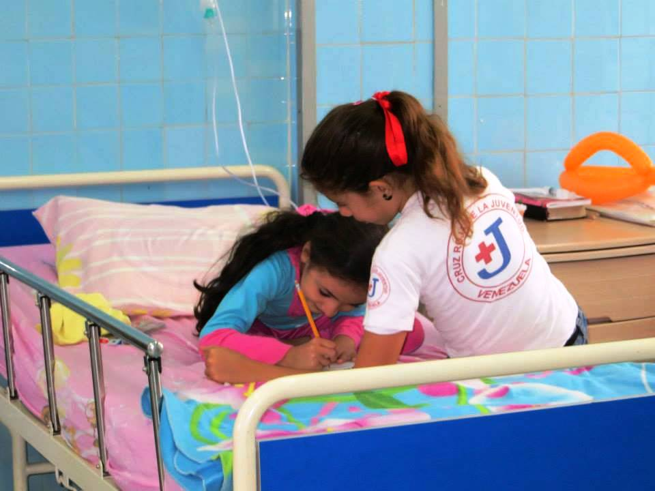
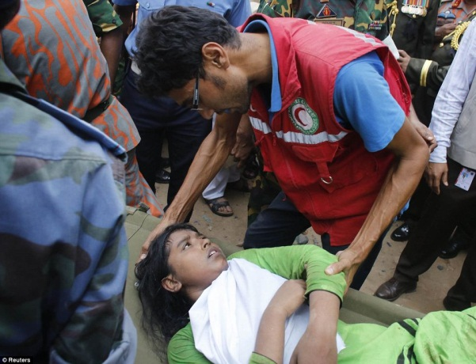
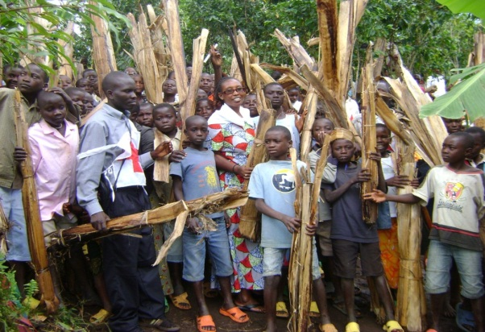
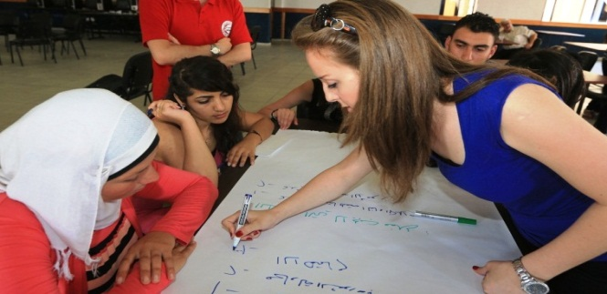
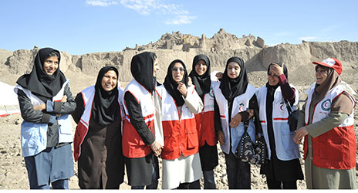
Corner stones of resilience in the Y.e.S.
“Well-equipped, Empowered, Healthy and enabled
children, adolescents, and young adults as agents of change”
Youth education
Youth
empowerment
RCRC creating enabling environments for youth
Humanitarian Education
Notes:
In this slide, key components/building blocks of the IFRC Y.E.S. are brought together.
Definitions are to be introduced – however, one should be reasonable with the level of details. Depending on the audience, once could probably focus and feature mainly on the new aspects of the definitions.
3Es concept (IFRC own framework introduced at the GYC 2012)
Importance of Youth Education
For children, adolescents, and young adults to take the lead in their capacities of volunteers, members, staff of National Societies, and beneficiaries, they need to be educated (in non-formal, formal, and informal settings). More specifically, they need to be provided with opportunities for development and practice of relevant life skills, values, and technical and administrative competences. Education means access to resources and equal opportunities.
Importance of Youth Empowerment
In regard to specific vulnerabilities due to combination of age, social position, and societal status, children, adolescents, and young adults need to be empowered throughout their engagement with Red Cross Red Crescent as volunteers and beneficiaries. More specifically, National Societies’ programs and services should allow for processes in which young people gradually acquire the ability, authority, and agency to make decisions and implement change in their own lives and the lives of other people (children, adolescents, young adults, and adults). Youth Empowerment means engaging young people in what and how National Societies do with and for young people.
Importance of Enabling environments for Youth
For educated and empowered children, adolescents, and young people to become agents of change participating and leading within National Societies’ service delivery, governance, leadership, and management, National Societies need to create enabling environments. More specifically, National Societies need to be educated in the realms of youth engagement and youth development. Changes of institutional environments, cultures, processes, structures, policies, regulations, etc., to enable thriving youth action in all domains and at all levels must be evidence based and informed by intergenerational dialogue. Enabling environments for youth are about realizing potential of groups and individuals within organisation.
Key youth definitions (Stemming from the IFRC Youth policy and amended by the Drafting team of the IFRC YES; endorsed by the Youth Commission)
Youth and Young people
The terms "youth" and "young people" in the IFRC cover people in the age range of 5 to 30 years. This includes children (5 to 11 years old), adolescents (12 to 17 years old), and young adults (18 to 30 years old). National Societies are guided reasonably by this range in adopting their own definitions according to local laws, social norms and cultural contexts.
Youth as Leaders
In Red Cross Red Crescent, youth can take a lead in their capacity as volunteers, members, and staff. Youth leadership is not exclusively about the title and position. It also entails and refers to specific abilities or unique qualities of young people to inspire and influence positive change by own actions in others or within their communities. Red Cross Red Crescent Youth leaders represent their peers and advocate for vulnerable and marginalized groups.
In-line with the IFRC Youth Policy (2011), Red Cross Red Crescent Youth leaders tackle contemporary and emerging issues; innovate and adopt modern media and IT; serve as inter-cultural ambassadors, agents of change, community mobilisers; participate in decision making, governance, and management; and utilise peer to peer approaches through their engagement in diverse Red Cross Red Crescent youth networks.
Youth as Volunteers
In Red Cross Red Crescent, young volunteers take the lead in planning, designing, delivering and reviewing of programs and services of National Societies. As deliverers of service and programs, they may have specific needs.
In general, Red Cross Red Crescent volunteers are individuals who carry out volunteering activities for a National Society, occasionally or regularly, without intention for personal gain. They do this by delivering services directly and indirectly to vulnerable people and through seeking to prevent and reduce human suffering and social exclusion where they can, based on their skills, capacities, and experiences. It is an obligation and responsibility of National Societies to ensure protection, safety, and security of all volunteers throughout their engagement.
Youth as beneficiaries
In Red Cross Red Crescent, young beneficiaries are all children, adolescents, and young adults who participate in, benefit from, and/or are empowered by Red Cross Red Crescent programmes and services.
Young beneficiaries are not passive receivers of aid. On the contrary, they are involved in the planning, design, delivery, and review of Red Cross Red Crescent programs and services affecting them. Throughout their engagement, National Societies must provide all the age categories of young beneficiaries with opportunities for advancement of their personal and professional development in the effort to enable their empowerment and giving back to their communities.

Slide 12
The Y.E.S. Cycle
1. RCRC Youth Volunteering
2. Youth Education
3. Youth Empowerment
4. Enabling Environments for
Youth
5. Change in the Self
6. Change in Communities
7. Change in the NS
Resilient communities

Slide 13
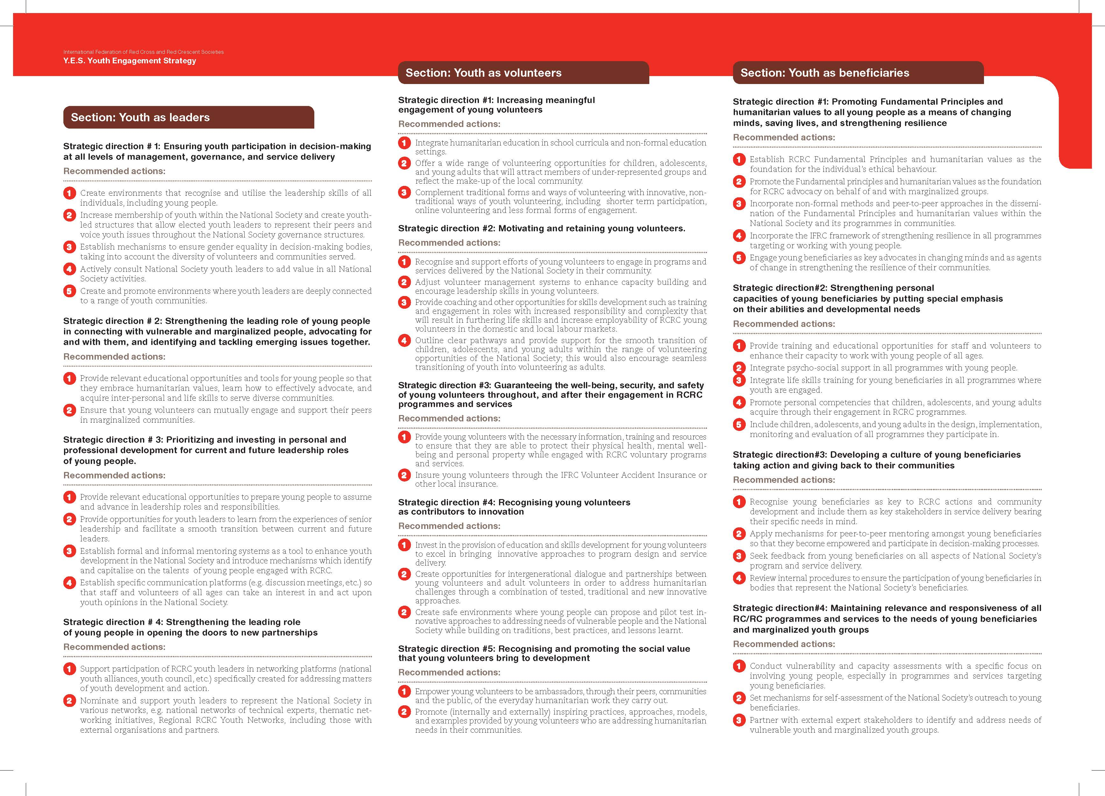
Notes:
13 SDs, 44 RAs

Slide 14
Youth as Leaders - IMPACT
Advocacy of National Societies for vulnerable and marginalized groups.
Creation of new partnerships for the benefit of programs and services of National Societies.
Personal and professional development opportunities of young people for assuming their current and future leadership roles within National Societies.
Youth engagement in decision-making process of National Societies at all levels.
Notes:
This slide is optional. It features expected positive impact of the Previous Strategic directions on the work of NSs.

Slide 15
Youth as Volunteers - IMPACT
Motivation and retention of young people engaging with programs and services of National Societies.
Social value that young volunteers bring to development of local communities and National Societies.
Diversification of the volunteers base of National Societies better mirroring makeup of local communities.
Well-being, security, and safety of young volunteers being guaranteed by National Societies.
Innovation of programs and services of National Societies through implementation of youth-led initiatives.
Notes:
This slide is optional. It features expected positive impact of the Previous Strategic directions on the work of NSs.

Slide 16
Youth as Beneficiaries - IMPACT
Relevance and responsiveness of RCRC programs and services to needs of young beneficiaries and marginalized and vulnerable youth.
Strengthening resilience of young beneficiaries while considering their abilities and developmental needs in project planning cycles of respective RCRC programs and services. .
Children, adolescents, and young adults considered three distinct groups participating in RCRC programs and services.
Nurturing of a culture of young beneficiaries taking actions and giving back to their communities.
Notes:
This slide is optional. It features expected positive impact of the Previous Strategic directions on the work of NSs.

Slide 17
Key factors impacting the cycle
1. RCRC Youth Volunteering
2. Youth Education
3. Youth Empowerment
4. Enabling Environments for
Youth
5. Change in the Self
6. Change in Communities
7. Change in the NS
Unemployability
Health risks
Resilient communities
Migration
Urbanisation
Notes:
These factors are based on review of literature on youth engagement and global trends.
These are to be seen as factors, where as violence is more of a consequence.
Global Trends Influencing Youth Engagement
Youths are shapers of, and shaped by the world around them. They are influenced by global trends, but also have the position to form these trends. Youths have a unique role in world development.
A world of youth Fact: People under the age of 30 make up half of the world’s population. Youth between 15 to 24 are a significant force in the world totalling more than one billion, most of which (90 %) live in developing countries (Euromointor International 2012). There are substantial regional differences in population development, some are facing younger populations, others are facing aging populations.
Impact: By merely looking at the numbers it is evident that involvement of youth can greatly expand and strengthen the capacity of the Red Cross and Red Crescent Movement (RCRCM ). In fact, already more than 60% of RCRC volunteers are young people taking a lead in addressing global humanitarian challenges. In a long term perspective these trends significantly impact the needs of vulnerable people . Only a healthy, strong and innovative RCRC will be able to meet the challenges ahead.
Unemployment and Education Fact: Nearly 75 million youths are unemployed, and among 10 % of the youths globally are not in employment, education or training (ILO 2012). Research shows that investments in youth generates the greatest returns when started in early childhood and continued through the transitions periods of youth. It is argued that adolescents are more adaptable and learn more quickly than adults (Pereznieto and Harding 2013). Volunteering early in life is a good predictor for volunteering later in life (Hall et. al 2009), and experts argue that investment in youth gives higher absolute returns because it generates change that will last through a lifetime(Pereznieto and Harding 2013).
Impact: Research and by global youth consultations, show that an increased focus on youth, young volunteers and their education and learning possibilities is crucial. Through humanitarian education and other training and education opportunities, RCRC youth beneficiaries, volunteers and leaders get new skills and knowledge that will strengthen their contribution to their communities and increase their chances of employment.
Diversity, Migration and Urbanization Fact: There is an increasing gap between rich and poor, and a changing rural-urban landscape. More than half the world live in urbanized areas, but 75 % of the world’s poor still live in rural areas. Urbanization brings challenges impacting youths such as slums, violence, pollution, and urban poverty (World Bank 2013).Young people are emerging in a global culture that is increasingly homogenising, through television and internet, whilst striving to maintain a local culture (UN 2003). Age, gender, income, ethnicity, disability, class, and location are factors that might impact exclusion, and often young women are particularly disadvantaged (Pereznieto and Harding 2013). Of the estimated 214 million international migrants 36-57 % are of 18-29 years of age (UN 2013) The Global Financial Crisis has made the challenges of migrants even more sever (PICUM 2012).
Impact: RCRC programs and volunteer opportunities have to be tailored to fit an increasingly diverse group of youths. Paying attention to the distinct needs of children, adolescents and young adults is essential. This should be strongly linked to RCRC work on building resilience in local communities. Youth migrants are among the most vulnerable groups and migration trends impact a wide variety of RCRC programs. However, young migrants should also be seen as important resources for the RCRC. By actively inviting all youth to become part of the RCRC we are at the forefront of fighting social exclusion and stigma. By praising diversity and see that ” Youth are not a homogenous group- every youth volunteer will have their own interest, and own skill sets just like all non-youth volunteers do” National Societies will attract more volunteers, and reach new target groups.
Health, Disasters and Climate Change Fact: Childbirth, sexually transmitted diseases/infections, tobacco, drugs and alcohol, poor diet and lack of physical activity are health risks that youth face. 16 million young girls give birth every day. Youths account for an estimate of 40% of all new HIV infections among adults worldwide. 20% of adolescents will experience a mental health problem (WHO 2011). Climate instability, disasters and environmental degradations is threatening youth development. Children and marginalized groups are most likely to lack essential natural resources and to be exposed to toxic and dangerous conditions (UNICEF 2013). 80% of the burden of disease from environmental determinants affect children (Pruss- Ustun and Corvalán 2006). Research shows that the most cost-efficient development investment involves early childhood development interventions (UNICEF 2013).
Impact: RCRC community-based health and first aid needs to take into account the health risks that youths are facing, and make use of the resource that youth volunteers bring. Community resilience is dependent on the involvement of youth. RCRC participation can also give better health by providing youth with knowledge, a network, an identity, new skills and a sense of achievement. By decreasing the gap between beneficiaries and volunteers one might increase the effectiveness of the RCRC programs, while at the same time invite more potential volunteers to the organization.
Peace and Participation Fact: Today, 1,3 billion people live in conflict-affected and fragile states (World Bank 2013b), and over 1.5 billion, of the world’s poorest people, live in states affected by violence (Muggah 2012). There is evidence of strong linkages between poverty, lack of opportunities and education and violence among youth. Young people who feel alienated from society and excluded from job opportunities and decision-making may turn to violence or crime (McLean and Fraiser 2009). Research shows that youth participation results in improved solutions, and strengthens youths understanding and commitment to democracy (UNICEF 2013).
Impact: Tailor made programs, that youth have participated in making, will provide youths with a set of skills to make a new start in live. Beneficiary involvement creates ownership, which increases the chances that beneficiaries want to become volunteers themselves. Participation is a fundamental right, and is one of the guiding principles of the Universal Declaration of Human Rights. If youths are to be the catalysts of change that they have the power to be, their voice needs to be heard. This implies involvement of youth on all levels in the RCRC Movement from top to bottom. Only then will we be able to meet the approaching global trends, and take advantage of that half the wold is below the age of 30.
Look in to: World disaster report, UNDP report, WHO report
Young people can be, and are, a significant force bringing new ideas, energy and entrepreneurship. Their multiple roles include being innovators, early adapters of communication, social media, and other technologies, inter-cultural ambassadors, peer-to-peer facilitators, community mobilisers, agents of behaviour change, and advocates for humanitarian issues.
In both the UN Youth World Report 2011 and the IFRC Y.E.S consultation process formal and informal education was highlighted as important. As put by a young Canadian volunteer (Jamaeff et.al 2012:32).

Slide 18
Qs&As
Notes:
This slide is a continuation of the previous one, in fact, in setting the “mood” for the IFRC Y.E.S.
These are messages for everybody in RCRC who works with children, adolescents, and young adults or has authority to decide on youth engagement.
Note that “Working with RCRC does not inherently benefit only young people, but also the communities they reside in.” linked to the resilience
Next slide focuses on the IFRC Y.E.S. introduction

Slide 19
IFRC Y.E.S. – FAQs
Is the IFRC Y.E.S. a Strategy or a Guidelines?
Are the contents of the IFRC Y.E.S. all new?
Who is going to implement the IFRC Y.E.S. and how?
What about measuring impact of the IFRC Y.E.S.?
What is the purpose of the Examples of Expected Impact in the IFRC Y.E.S.?
Why are there ”repetitions” of some of the Recommended actions in the document?
Is not Education and Empowerment the same?
Are not some of the Strategic directions vague?
Is the IFRC Y.E.S. really to be read by local branch volunteers?
What will happen in the GA 2013?
Does not the IFRC Y.E.S. have a way too many pages?
Notes:
Find answers here – towards the end of the recording – approximately after 60 minutes: https://ifrc.webex.com/ifrc/ldr.php?AT=pb&SP=MC&rID=3297982&rKey=A58267EA0CA04C4B Webex training - IFRC Y.E.S. presentation-20130506 1510-1 May 6, 2013, 6:43 pm Paris Time 1 hour 19 mins
The link will expire in 3 weeks.
Qs not on the recording:
6. Fluidity of the 3Es and the definitions Yas L, V, and B is the main reason for repetition. The are holistic and we did not want to merge as it would cut down the options of the “menu” for NSs to choose.
7. It depends on culture of the reader. Practitioners of youth engagement will know how each SD can be translated in to action in their context.

Slide 20
Featured aspects of the IFRC Y.E.S. :
Unifying global strategic framework for youth engagement built on previous experiences and extensive consultation with youth and National Society leadership.
Underscoring 3 distinct age groups of youth – children, adolescents, young adults.
Emphasising engagement of marginalised groups.
Elevating engagement of young beneficiaries.
Visionary, yet reflecting the realities and previous experiences of National Societies.
Cross cutting and featuring the value-add that youth bring to service delivery;
Reinforces an intergenerational, holistic, and dynamic approach to youth engagement.
Contributes to strong engagement of youth in leading the IFRC position in the post-2015 development agenda.

Slide 21


Stay tuned and informed
IFRC Y.E.S. page

Slide 22
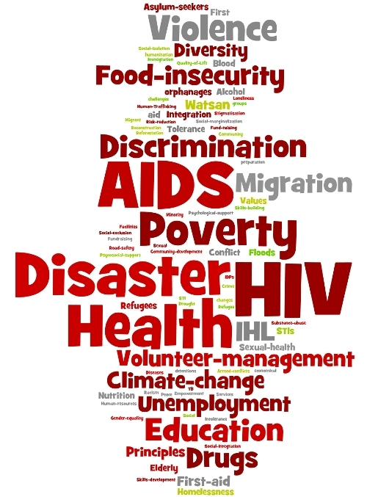
Humanitarian challenges – Solferino, 2009
Notes:
Solferino 2009
SA of the S2020
Save lives, protect livelihoods, and strengthen recovery form disasters and crisis.
Enable healthy and save living.
Promote social inclusion and a culture of non-violence and peace.

Slide 23
Young Humanitarians – Today’s HenryS
Appealed to the leaders of the world thus they:
Recognize youth as agents of change.
Encourage the use of unique abilities and skills that young people alone can bring to the table, such as intercultural communication and innovative use of technology.
Include youth in decision-making and planning processes at all levels.
Push for youth to have a stronger role in programme development and implementation to empower their communities.
Increase focus on formal and non-formal peer education as a primary method of prevention.
Notes:
Solferino Declaration

Slide 24

IFRC Y.E.S. – endorsed by the GA 2013
Notes:
Fireworks for each NS to follow the IFRC Youth Policy and the IFRC Y.E.S. in its developmental plans.
Questions and comments?

Slide 25
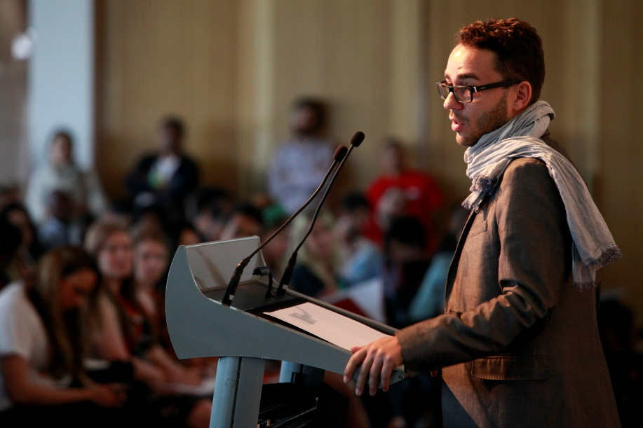
Thank you for your attention
For further information on youth engagement and development
Marcel Stefanik
Senior officer
Youth Action and Volunteering Development dpt.
IFRC Secretariat
Tel.: +41 (0) 22 730 4222
E-mail: stefanik.marcel@ifrc.org

